Slide 1
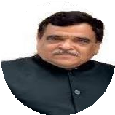
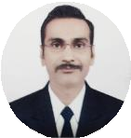
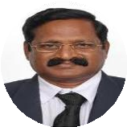
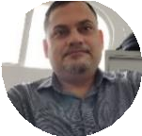
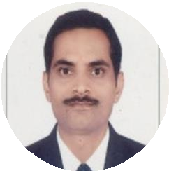
Batch-VIII
By
C.G. Bhakta Institute of Biotechnology
Duration : 24/11/2023 to 03/12/2023
(3 hours per day, Total 30 hours)
Course Fee: INR. 700. Only
Eligibility
Any Bioscience/Pharmacy/Medical/Agriculture graduates, Post graduate and Research scholar.
Mentor
Dr. Dinesh R Shah , Provost, Uka Tarsadia University.
Resource Persons
Dr. Ravi Vijayvargia: Asst. Professor, Dept. of Biochemistry, The M.S. University of Baroda. Postdoc from UM DNJ-Rutgers University, New Jersey and MGH-Harvard Medical School, Boston USA.
Chair Person
Dr. Prof. R. Krishnamurthy, Director, C. G. Bhakta Institute of Biotechnology, Uka Tarsadia University.
Coordinator and Resource Person
Dr. Gopal Jee Gopal. Asst. Prof. Uka Tarsadia University, PhD from Special centre for Molecular Medicine, JNU. He is CSIR-NET-JRF, D.S Kothari Post-Doc Fellow, Fast Track young Scientist (SERB,DST). Conducted 26 batches of online course in Recombinant DNA Technology and 7 batches of Genomics and Proteomics course
Dr. Hem Chandra Jha, Associate Professor, IIT, Indore. Recipient of Ramanujan Fellowship, Fellow of Royal Society of Biology
Mr. Ashwani Kumar Mishra: Founder of DNA Xperts P vt. Ltd. Noida
Registration
Deadline23/11/2023 4:00 pm.
Contact detail :
Dr. Gopal Jee Gopal (Co-ordinator),
Email Id: gopal.jee@utu.ac.in,
Cont No: 09558880617, 08160245501
Registration link: http://cgbibt.edu.in/OnlineCourse.html
Follow us on LinkedIn: www.linkedin.com/in/gopal-jee-gopal-a2312529

Slide 2
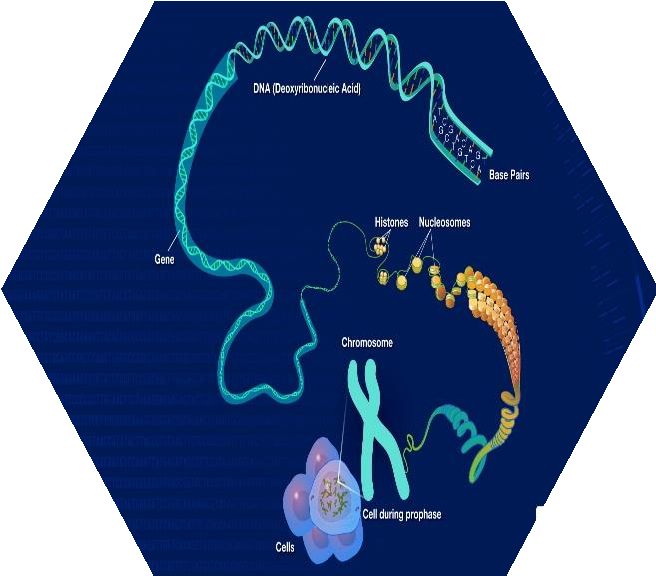
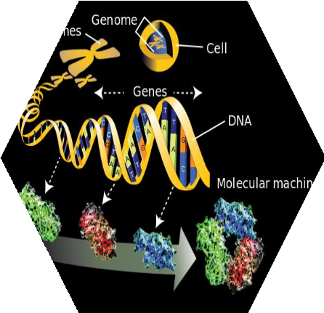
Course Details
Online Platform for Lectures:
Topics covered: Introduction to Genomics and Proteomics, Structure and Function of Nucleotide, Amino acid, DNA( Gene) and Protein, Gel electrophoresis for separation of DNA and Protein, Sequencing of DNA and protein, Protein purification and identification, Determination of targeted Gene expression and Global Gene expression, Post Translational Modification and analysis, Protein/Protein and Protein/ DNA Interaction.
Registration link: http://cgbibt.edu.in/OnlineCourse.html
Timing:
5.30 pm to 8.30 pm
Expected outcome: Participants will understand the basics of genomics and proteomics
and will be aware of about different techniques used in proteomics and genomics.
Note: You will Receive a Google meet link, and other details on 23/11/2023 (Morning). Download the payment receipt after you pay the course fees and keep it with you.

